Slide 1




PDS
AWS VPC (Virtual Private Cloud)
Computer Vision
https://github.com/siagianp
https://www.youtube.com/@AmelOline/videos
https://github.com/amelcharolinesgn2/Cloud-Infrastructures
https://github.com/amelcharolinesgn2/ClouD-Infrastructure-SISKA-2025
https://github.com/amelcharolinesgn2/CCNA1
https://github.com/amelcharolinesgn2/CCNA2
https://github.com/amelcharolinesgn2/AWS Certificate
Notes:
Lab Session 01: AWS Compute Foundations – EC2, Networking, and Application Deployment Lab Session 02: Identity and Access Control with IAM Lab Session 03: Cloud Storage Solutions – S3, EBS, and EFS Lab Session 04: Database Services – RDS, DynamoDB, and ElastiCache Lab Session 05: Load Balancing and Auto Scaling Lab Session 06: Container Orchestration with ECS, Fargate, and EKS Lab Session 07: Serverless Computing with Lambda Lab Session 08: Monitoring, Logging, and Security Auditing Lab Session 09: Infrastructure as Code – CloudFormation, CDK, and Terraform Lab Session 10: CI/CD Pipelines – App Runner, CodePipeline, GitHub Actions, and CodeDeploy Lab Session 11: AI/ML Services – Rekognition, Comprehend, Translate, and SageMaker Lab Session 12: Hybrid Cloud Networking – VPC Peering, Transit Gateway, VPN, and Direct Connect Lab Session 13: Security and Compliance – AWS Config, GuardDuty, Security Hub, and KMS Lab Session 14: Disaster Recovery and Business Continuity – AWS Backup, Multi-Region, and Failover Lab Session 15: Migration and Modernization – DataSync, DMS, MGN, Containers, and Serverless
Lab Session 16: Cost Management and Optimization – Cost Explorer, Trusted Advisor, Budgets, and Well-Architected
https://www.youtube.com/watch?v=SOTamWNgDKc&t=19604s

Slide 2
AWS VPC (Virtual Private Cloud)
Building Secure and Scalable Cloud Networks

Slide 3
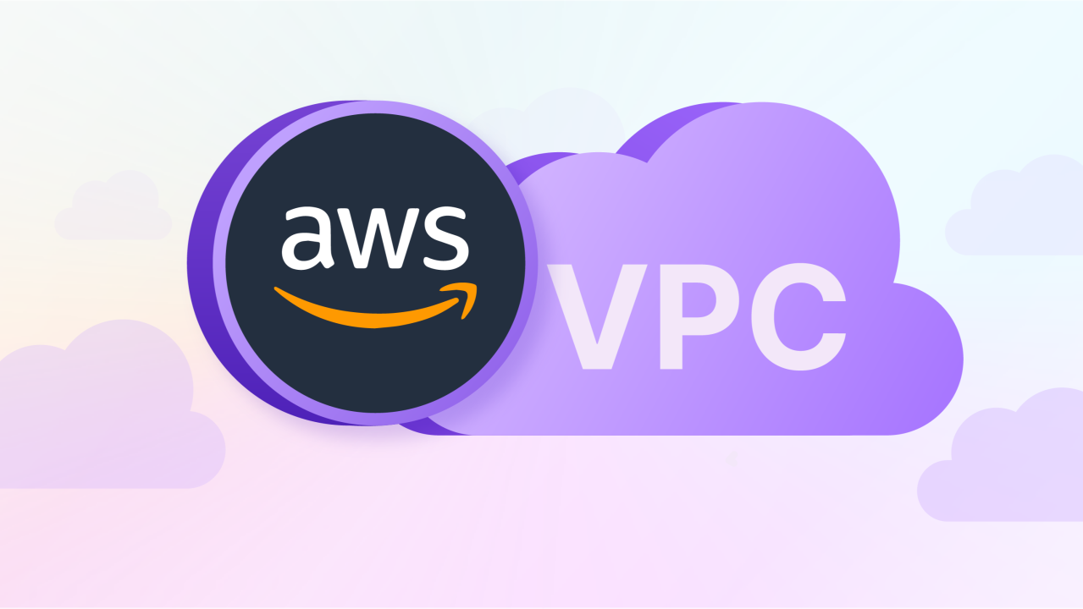
What is Amazon VPC?
Amazon Virtual Private Cloud (VPC) is a logically isolated section of the AWS Cloud where you can define your virtual network.
Purpose:
Launch AWS resources in a secure and controlled environment.
Customize networking to meet specific requirements.
Use Cases:
Hosting web applications securely.
Extending on-premises data centers to the cloud.
Creating multi-tier architectures.

Slide 4
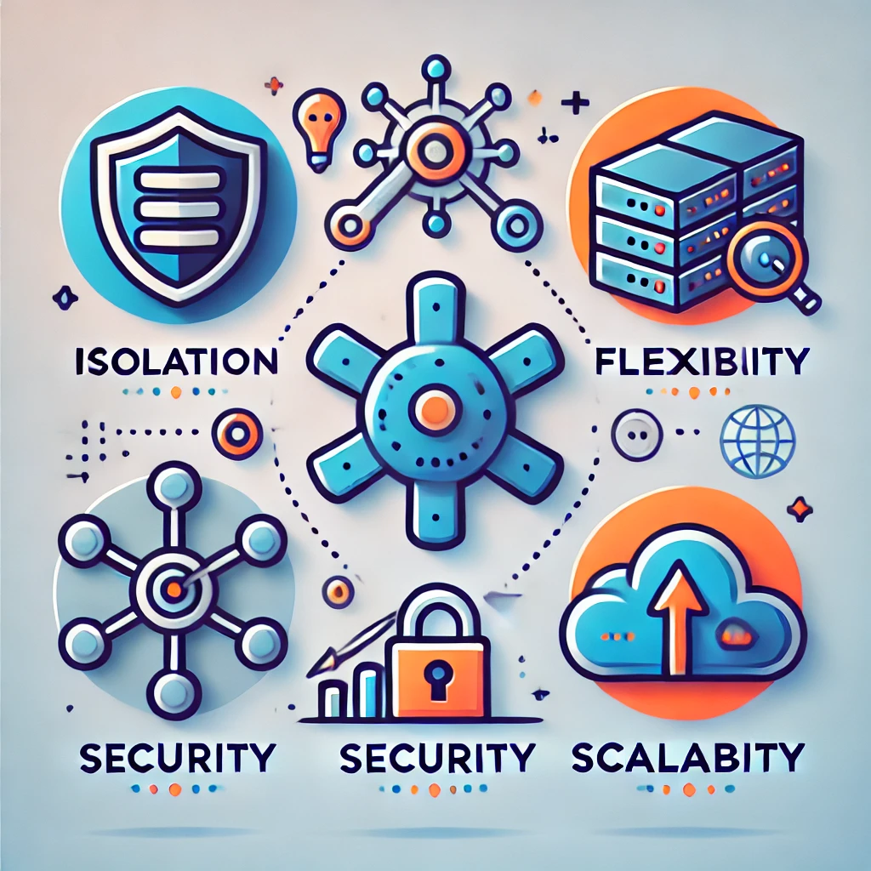
Key Benefits of Amazon VPC
Isolation: Fully isolate resources for enhanced security.
Flexibility: Customize IP addressing, subnets, and routing.
Security: Leverage security groups and network ACLs.
Scalability: Expand resources as needed without manual reconfiguration.

Slide 5
Core Components of a VPC
Subnets: Public and private sub-networks within a VPC.
Route Tables: Rules for directing traffic within the network.
Internet Gateway (IGW): Access the internet from your VPC.
NAT Gateway: Allow private instances to initiate internet connections.
Elastic IP (EIP): Static public IP for resources.

Slide 6
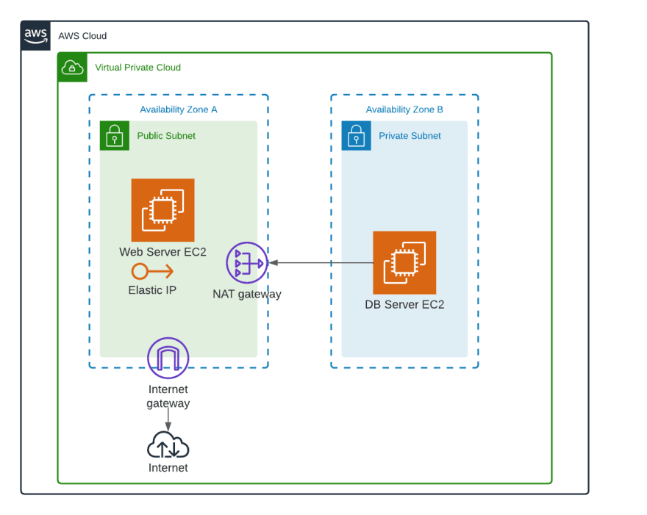
Public and Private Subnets
Public Subnet:
Direct internet access via the Internet Gateway (IGW).
Ideal for web servers and other public-facing resources.
Private Subnet:
No direct internet access.
Used for sensitive resources like databases and backend systems.

Slide 7
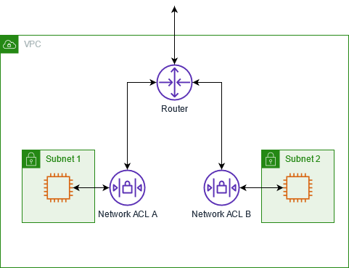
Security Features in VPC
Security Groups:
Instance-level firewall.
Controls inbound/outbound traffic.
Network ACLs (Access Control Lists):
Subnet-level firewall.
Allows/denies traffic at the subnet level.

Slide 8
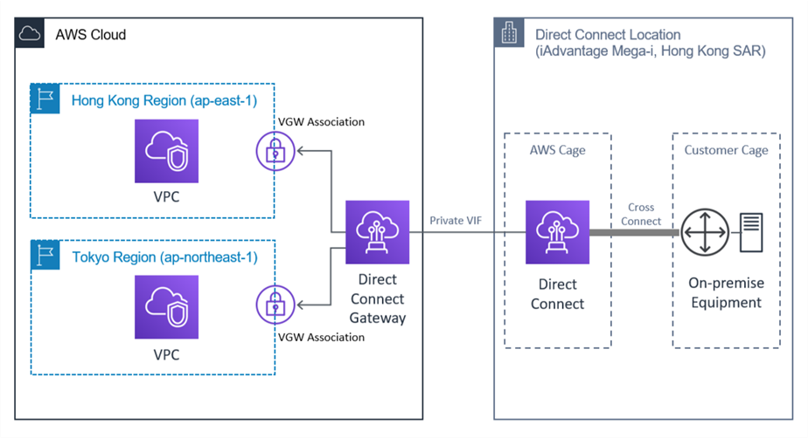
Connecting to VPC
Internet Gateway (IGW): Enables internet access for public subnets.
VPN and Direct Connect: Securely connect your on-premises network to AWS.
Peering Connections: Connect multiple VPCs for resource sharing.

Slide 9
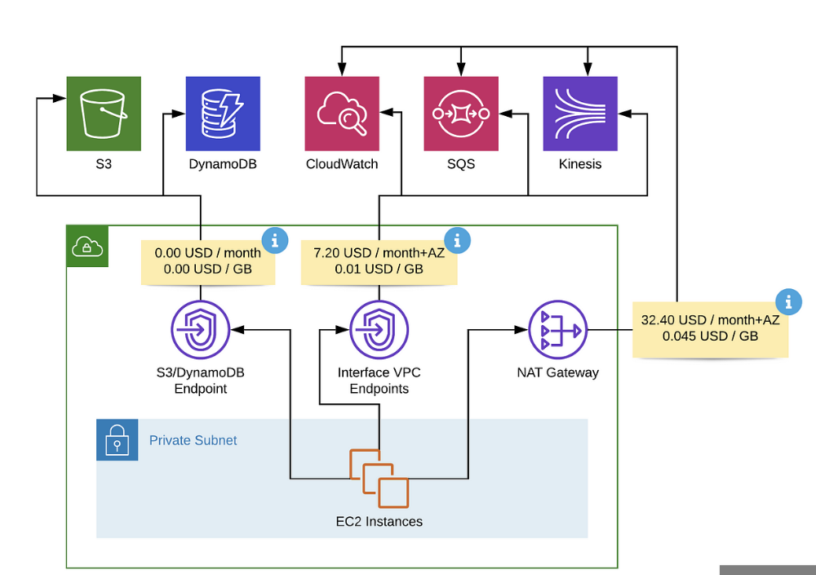
Advanced Networking in VPC
NAT Gateway: Allow instances in private subnets to access the internet without exposing them.
Elastic Load Balancer (ELB): Distribute traffic across instances in public and private subnets.
VPC Endpoints: Privately connect VPC to AWS services without using IGW or NAT.

Slide 10
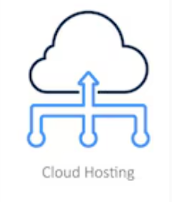
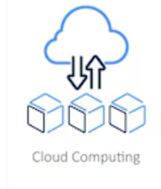
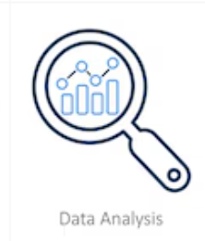
VPC Use Cases
Web Hosting: Deploy scalable, secure web applications.
Hybrid Cloud: Extend on-premises networks using VPN or Direct Connect.
Data Analytics: Run secure data analysis workflows.

Slide 11
VPC Best Practices
Design subnets for specific use cases (public, private, isolated).
Use least privilege principles with security groups and ACLs.
Monitor traffic using VPC Flow Logs.
Leverage NAT Gateways for secure internet access from private subnets.

Slide 12
Summery
VPC provides isolated, secure, and customizable networking in AWS.
Plan and design the VPC architecture based on application needs.
Utilize security and monitoring tools to safeguard resources.

Slide 13
THANK YOU
Amel charoline
Amel Online & Irene magdalena
https://github.com/siagianp
https://www.youtube.com/@AmelOline/videos
https://github.com/amelcharolinesgn2/Cloud-Infrastructures
https://github.com/amelcharolinesgn2/ClouD-Infrastructure-SISKA-2025
https://github.com/amelcharolinesgn2/CCNA1
https://github.com/amelcharolinesgn2/CCNA2
https://github.com/amelcharolinesgn2/AWS Certificate

